Slide 1
Attrition Study
DS6306 Case Study 2

Slide 2
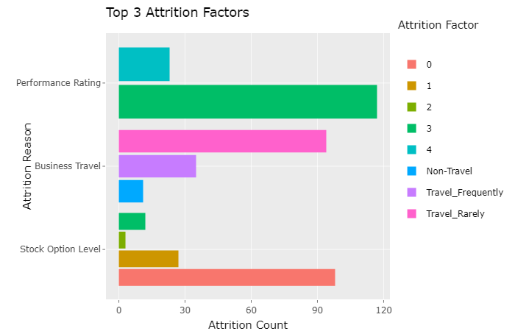
Top 3 Attrition Factors

Slide 3
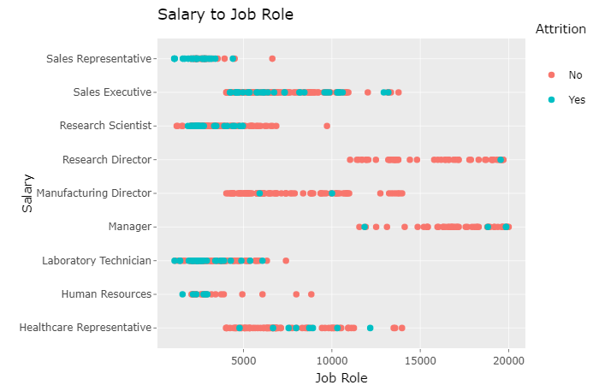

Slide 4
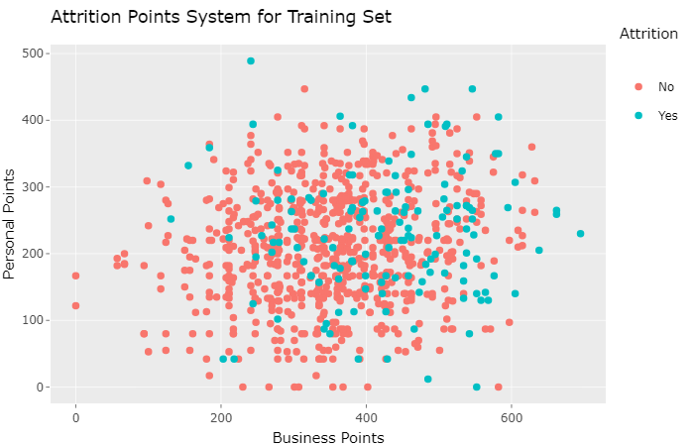

Slide 5
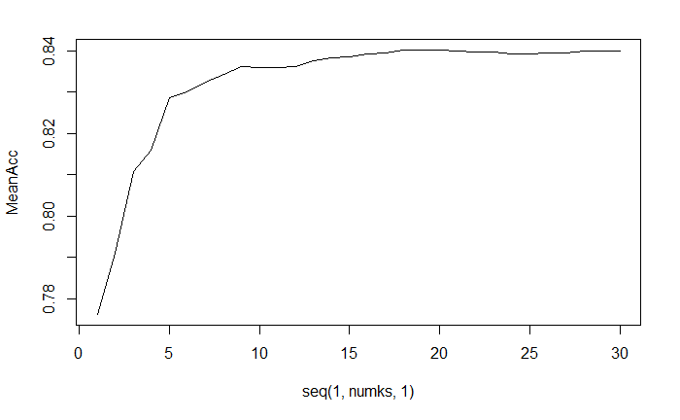
Model Accuracy
Classifications No Yes
No 207 33
Yes 15 6
Confusion Matrix and Statistics
Accuracy : 0.8161
Sensitivity : 0.9324
Specificity : 0.1538

